Slide 1
Module-2
Water Treatment
Topics: Water softening methods: - Lime-soda, Zeolite and ion exchange processes and their applications. Specifications of water for domestic use (ICMR and WHO); Unit processes involved in water treatment for municipal supply - Sedimentation with coagulant- Sand Filtration - chlorination; Domestic water purification – Candle filtration- activated carbon filtration; Disinfection methods - Ultrafiltration, UV treatment, Ozonolysis, Reverse Osmosis; Electro dialysis.

Slide 2



Lime[Ca(OH)₂] required for softening
74
[ Temp. Ca²⁺ + 2×Temp. Mg²⁺ + Perm. (Mg²⁺ + Fe²⁺ + Al³⁺)
+ CO₂ + H⁺ (HCl or H₂SO₄) + HCO₃⁻] x Volume of water(V)
100
100 parts by mass of CaCO₃ ≡ 74 parts of Ca(OH)₂
1 part of CaCO₃ ≡ 74/100 of Lime
Soda [Na₂CO₃] required for softening
106
[ Perm. (Ca²⁺ + Mg²⁺ + Fe²⁺ + Al³⁺) + CO₂ + H⁺ (HCl or
H₂SO₄) - HCO₃⁻] x Volume of water (V)
100
100 parts by mass of CaCO₃ ≡ 106 parts of Ca(OH)₂
1 part of CaCO₃ ≡ 106/100 of Lime
All components in CaCO₃ equivalent
V = volume of water
Final result in mg >>> kg

Slide 3

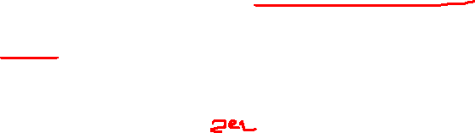
Lime Soda Process - Reactions of Lime and Soda
Lime removes the temporary hardness:
Ca(HCO₃)₂ + Ca(OH)₂ → 2 CaCO₃ ↓ + 2 H₂O
Mg(HCO₃)₂ + 2 Ca(OH)₂ → 2 CaCO₃ ↓ + MgCO₃ ↓ + 2 H₂O
Soda and Lime removes the magnesium permanent hardness:
MgCl₂ + Ca(OH)₂ → CaCl₂ + Mg(OH)₂ ↓
CaCl₂ + Na₂CO₃ → CaCO₃ ↓ + 2 NaCl
MgSO₄ + Ca(OH)₂ → CaSO₄ + Mg(OH)₂ ↓
CaSO₄ + Na₂CO₃ → CaCO₃ ↓ + Na₂SO₄

Slide 4
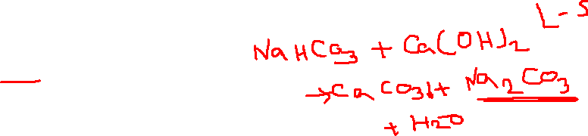
Soda removes all calcium permanent hardness:
CaCl₂ + Na₂CO₃ → CaCO₃ ↓ + 2 NaCl
CaSO₄ + Na₂CO₃ → CaCO₃ ↓ + Na₂SO₄
Reaction of CO₂:
CO₂ + Ca(OH)₂ CaCO₃ + H₂O
Reaction of H⁺:
2 H⁺ + Ca(OH)₂ Ca²⁺ + 2 H₂O
Ca²⁺ + Na₂CO₃ CaCO₃ + 2 Na⁺
Reaction of HCO3‒ (Example: NaHCO3)
2HCO₃‒ + Ca(OH)₂ → CaCO₃ ↓+ CO₃^{2‒} + H₂O

Slide 5
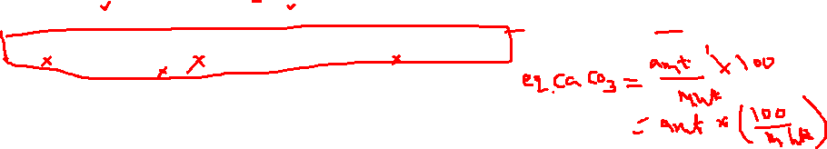
Example
1. Calculate the amount of lime and soda required for softening 50,000 liters of hard water containing Ca(HCO₃)₂= 81 ppm, Mg(HCO₃)₂ = 73 ppm, CaCl₂ = 222 ppm, MgSO₄= 180 ppm, Na₂SO₄ = 15 ppm, NaCl = 165 ppm, and Fe₂O₃ = 25 ppm.

Slide 6
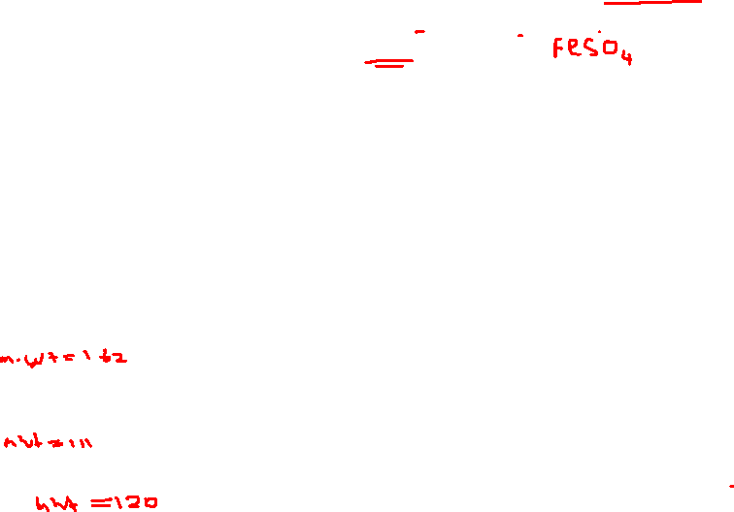
Example
1. Calculate the amount of lime and soda required for softening 50,000 liters of hard water containing Ca(HCO₃)₂= 81 ppm, Mg(HCO₃)₂ = 73 ppm, CaCl₂ = 222 ppm, MgSO₄= 180 ppm, Na₂SO₄ = 15 ppm, NaCl = 165 ppm, and Fe₂O₃ = 25 ppm.
Sol: No hardness is caused by Na₂SO₄, NaCl, and Fe₂O₃ (insoluble solid), so they should not be included in the calculations.
Conversion to CaCO₃ equivalents
Constituent | ppm | Multiplication factor (M.Wt. of CaCO₃/ M.Wt. of Constituent) | CaCO₃ equivalents
Ca(HCO₃)₂ | 81 | 100/162 | 81 x 100/162 = 50 ppm
Mg(HCO₃)₂ | 73 | 100/146 | 73 x 100/146 = 50 ppm
CaCl₂ | 222 | 100/111 | 222 x 100/111 = 200 ppm
MgSO₄ | 180 | 100/120 | 180 x 100/120= 150 ppm

Slide 7
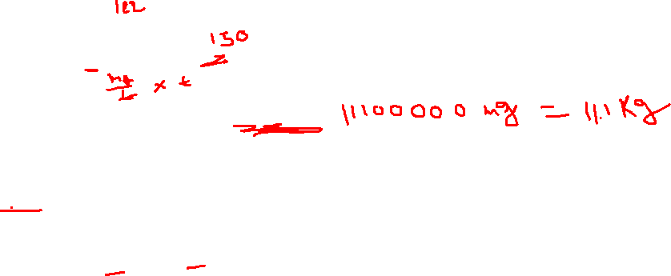
Lime required for softening 50,000 L of Water
Soda required for softening 50,000 L of Water

Slide 8
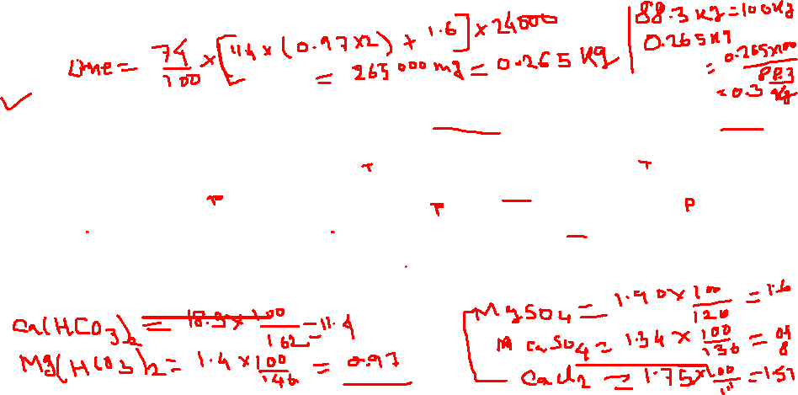
Calculate the amount of lime and soda required to soften 50000 L of the water sample containing Mg(HCO₃)₂ = 15.6 mg/L; Ca(HCO₃)₂ = 34.4 mg/L; MgSO₄ = 60 mg/L; CaCl₂ = 25 mg/L; MgCl₂ = 35 mg/L; SiO₂ = 25 mg/L; NaCl = 20mg/L. [Ca = 40; Mg = 24; H = 1; C = 12; O = 16; Cl = 35.5, S = 32]
Calculate the amount of lime (88.3% pure) and soda (99.2% pure) for treatment of 24,000 liters of water, whose analysis is as follows: Ca(HCO₃)₂ = 18.5 ppm; Mg(HCO₃)₂ = 1.42 ppm; MgSO₄ = 1.90 ppm; CaSO₄ = 1.34 ppm; CaCl₂ = 1.75 ppm. Also calculate the carbonate and non-carbonate hardness of the water sample.

Slide 9
Calculate the amount of lime and soda required to soften 50000 L of the water sample containing Mg(HCO₃)₂ = 15.6 mg/L; Ca(HCO₃)₂ = 34.4 mg/L; MgSO₄ = 60 mg/L; CaCl₂ = 25 mg/L; MgCl₂ = 35 mg/L; SiO₂ = 25 mg/L; NaCl = 20mg/L. [Ca = 40; Mg = 24; H = 1; C = 12; O = 16; Cl = 35.5, S = 32]
Lime = 4.789 kg
Soda = 5.796 kg
Calculate the amount of lime (88.3% pure) and soda (99.2% pure) for treatment of 24,000 liters of water, whose analysis is as follows: Ca(HCO₃)₂ = 18.5 ppm; Mg(HCO₃)₂ = 1.42 ppm; MgSO₄ = 1.90 ppm; CaSO₄ = 1.34 ppm; CaCl₂ = 1.75 ppm. Also calculate the carbonate and non-carbonate hardness of the water sample.
Lime = 0.3 kg
Soda = 0.106 kg
non-carbonate hardness = 12.39 ppm
carbonate hardness = 4.141

Slide 10


A sample water on analysis has been found to contain the following impurities in ppm: Ca(HCO₃)₂ = 48.6; Mg(HCO₃)₂ = 29.2; MgCl₂ = 3.8; CaCl₂ = 33.3; CaSO₄ = 54.4; NaCl = 659. Calculate the quantity of lime and soda required for softening one million liters of water {Atomic weight: Ca = 40; Mg = 24; H = 1; C = 12; O = 16; Cl = 35.5, S = 32}
Calculate the amount of lime (85%) and soda (90%) required for softening 50,000 litres of hard water containing following impurities (mg/L): CaSO₄ = 40, MgCl₂ = 46, Mg(HCO₃)₂ = 82 , Ca(HCO₃)₂ = 35, KCl = 10

Slide 11

Explain with chemical equations and calculate the amount of lime and soda needed for softening 1,00,000 liters of water containing the following: HCl = 7.3 mg/L; Al₂(SO₄)₃ = 34.2 mg/L; MgCl₂ = 9.5 mg/L; NaCl = 29.25 mg/L. Purity of Lime is 90% and purity of soda is 98%. 10% of Lime and Soda are to be used in excess in order to complete the reaction quickly.
Lime = 4.522 kg
Soda = 4.949 kg
6. Calculate the amount of lime and soda required for the treatment of 10,000l of water containing the following salts dissolved per litre. CaCO3=50 mg, CaCl2=11.1 mg, MgSO4=12 mg, NaHCO3=7.25 mg, silica=10 mg.

Slide 12
7. Calculate the amount of lime and soda required for the treatment of 10,000l of water containing the following salts dissolved per litre. CaCO3=60 mg, CaCl2=11.1 mg, MgSO4=12 mg, NaHCO3=7.25 mg, NaHCO3 = 183.

